Slide 1
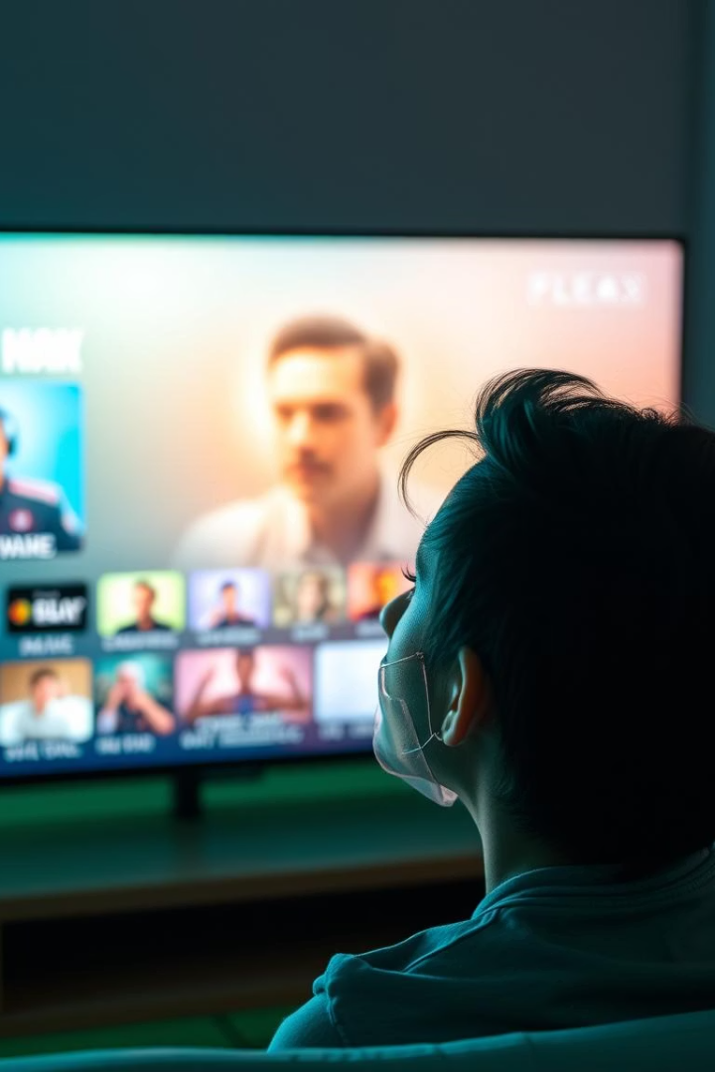
StreamFlix
Transitioning to a Subscription-based model
Group 2
Team Members
Kurt Iriart
Kalai Yuvaraj
Saraswathi
Cyndi Li Shan
Cliff Asmussen

Slide 2
Overview
This presentation outlines StreamFlix’s transition to a subscription-based platform.
Using data-driven insights, we will guide key decisions, optimize audience engagement, and refine content acquisition strategies.
Dynamic dashboards will highlight critical trends and provide actionable recommendations for future success.

Slide 3




Transition Goals
Revenue Growth
User Retention
Content Optimisation
Enhanced Experience
Maximise existing user conversion.
Increase subscription revenue streams.
Align content with subscriber preferences.
Deliver a premium, ad-free viewing.

Slide 4
Key Insights
1
Top 10 Movies
2
Most Popular Genres
Identify highly-rated content for acquisition.
Understand audience content preferences.
3
Age-Based User Distribution
4
User Subscription Distribution
Segment users by demographics.
Monitor conversion and retention rates.
5
User Distribution by Country
6
Device Usage by User
Analyse geographic audience distribution.
Optimise platform across devices.

Slide 5


Slide 12




Strategic Recommendations
Targeted Content Acquisition
1
Prioritize high-demand genres and top-rated titles to maximize subscriber engagement and retention.
Boost inclusivity to attract more female customers.
2
Implement targeted strategies to foster inclusivity and attract more female customers.
Leverage free users to upsell premium features.
3
Potential for upselling premium features or exclusive content..
Device specific engagement strategies
4
Tailor content while ensuring cross-device continuity.
Focus on content, engagement, and model optimization by acquiring more drama, comedy, and horror titles, prioritizing recent '90s movies. Tailor content and features across devices, offer premium perks to drive growth and loyalty, and target female subscribers to enhance diversity and balance.

Slide 13
Challenges & Solutions
Low ratings per movie make popularity data unreliable.
1
Encourage more user ratings while leveraging external sources for reliable movie popularity data.
No watch time breakdown by movie or genre.
2
Track watch time by movie and genre to identify high-engagement content.
No view counts per device.
3
Track view counts per device to improve recommendations and insights...
High-quality, complete data is essential. Enhancing data collection to track movie-specific rates, movie and genre watch time and device-based views will improve audience insights and guide smarter content acquisition decisions.

Slide 14
Thank You

